Slide 1

Operating System Security (CYS337)
Bypassing Windows Admin Login Page Using CMD
James Soko (20231392)
Group 3
2nd September, 2025

Slide 2
QUESTION
Design a Power Point Presentation on how to Crack Windows Login Admin Account Using CMD.

Slide 3
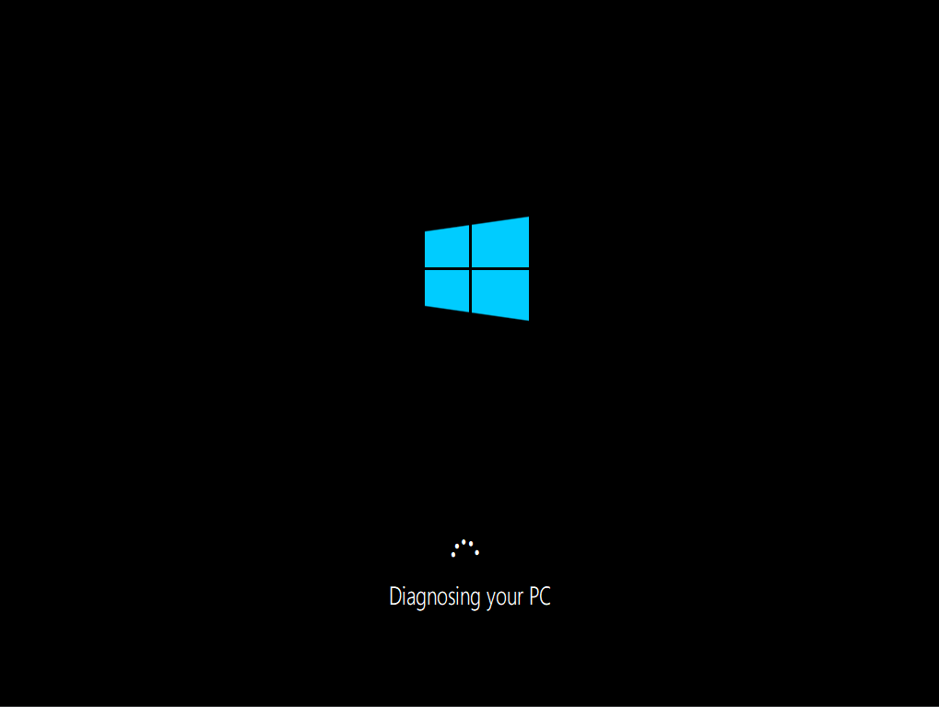
Repair Mode
Go into Windows repair mode, by forcing shutdown three (3) times.
The main essence of doing this is that a computer is vulnerable when its offline.

Slide 4
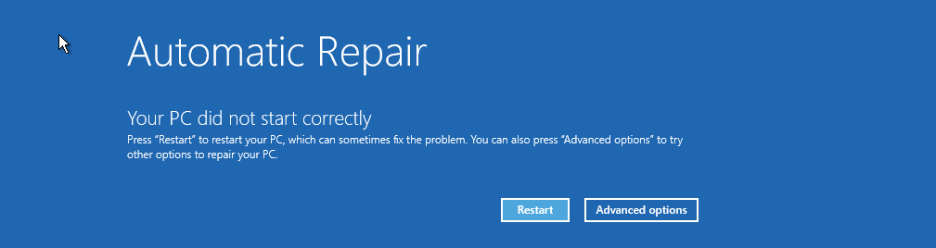

Advanced Options
Click on Advanced Options → Trouble Shoot

Slide 5

Recovery Options
Advanced Options → See More Recovery Options
At this stage, we can just go direct with Command Prompt (CMD) and use the rename command as shown on slide 16.
This is recommended for devices that require a password to access the Image Recovery.

Slide 6
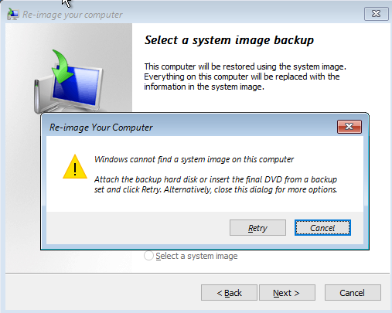
Image Recovery
Select System Image Recovery
What ever will pop up on the screen, click on Cancel

Slide 7
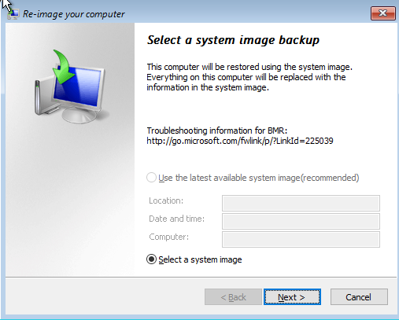
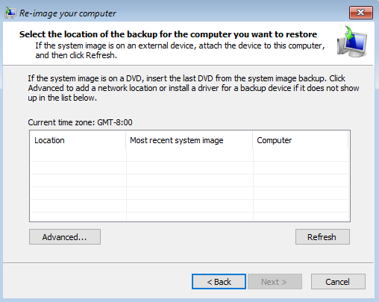
Image Recovery (Continues…)
Select a system image backup → Next > → Advanced…

Slide 8
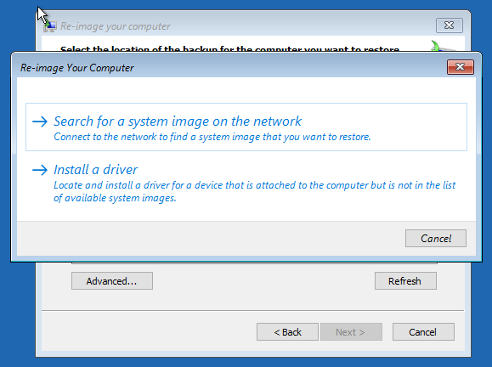
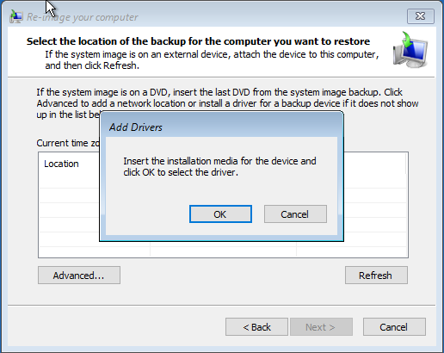
Image Recovery (Continues…)
A new window will pop, click Install a Driver → OK

Slide 9
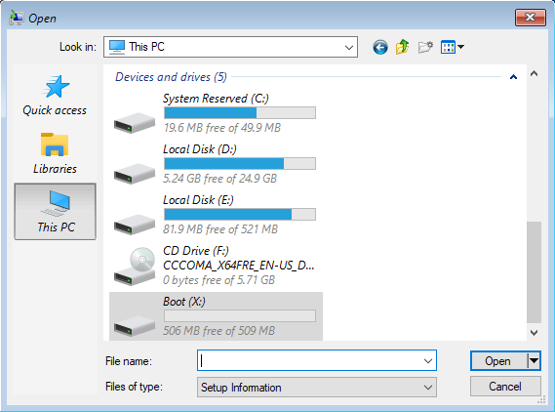
Local Disk (C) / (D)
Go on This PC → Local Disk (C) / (D)
Depending on where your boot files files are, that’s the Disk your would like to select.
On this Virtual Machine, the files are in Local Disk (D).

Slide 10
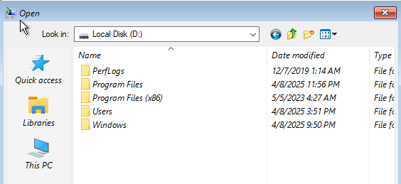
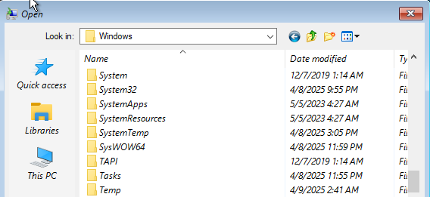
System32
Click on This PC and Navigate the Folders; Windows → System32

Slide 11
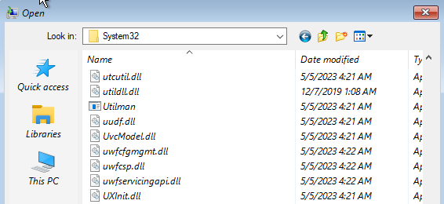
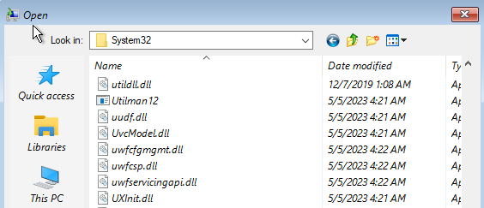
Utility Manager (Utilman)
Find the file called Utilman and Rename it (e.g., Utilman12) and Refresh the screen.

Slide 12
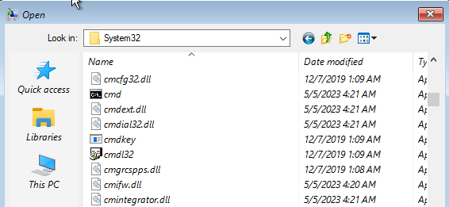
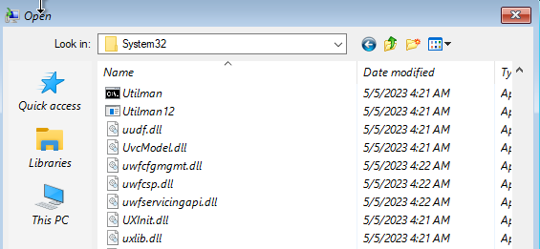
Command Prompt (CMD)
Locate cmd and Rename it to Utilman and Refresh the screen.

Slide 13


Ease Acess
Close all the windows or tabs then click on Continue, wait for your Computer to restart and click on the Magic Icon (Accessibility) which is next to the Internet Icon.
The whole idea for this practical lab is that we are exchanging the roles of CMD and the Utility Manager.

Slide 14
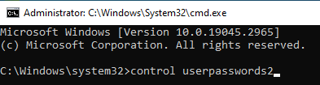
User Accounts
Command Prompt will appear, type in the command; control userpasswords2

Slide 15
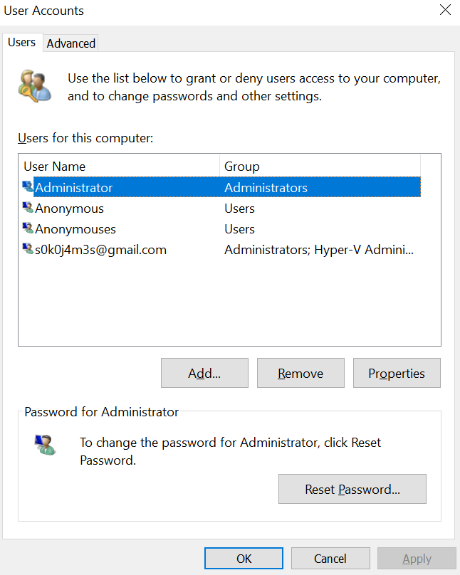
User Accounts (Continues…)
Then under User Accounts, click Reset Password…
Enter New Password or leave it blank and click on OK

Slide 16




Command Prompt
Use the commands below to achieve this entire lab;
rename Utilman.exe Utilman12.exe
rename cmd.exe Utilman.exe
shutdown /r /t 00
Click on the Ease Access icon and once Command Prompt pops up, enter the command: control userpasswords 2

Slide 17
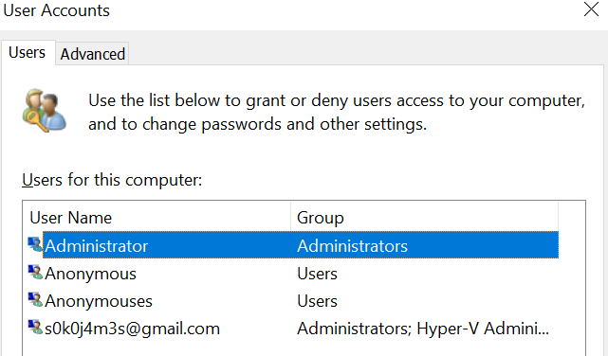
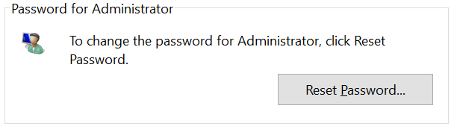
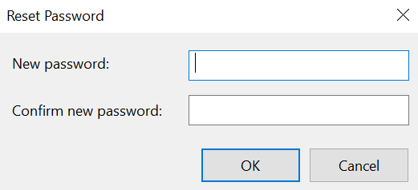
User Accounts
Select the Administrative Account
Click on Reset Password…
Leave blank or enter New password

